Slide 1

Presented By:
Saaransh Panjrath (20211502819)
Harshvardhan Joshi (20511502819)
Prabhakar Kumar (20911502819)
Shrey Goel (21011502819)
Gesture & Sign Language Assistance
20/05/2022
20/05/2022
20/05/2022
<number>

Slide 2
PREVIEW
INTRODUCTION
OBJECTIVE
LITERATURE SURVEY
PROPOSED METHODOLOGY
IMPLEMENTATION
RESULT & FUTURE WORK
REFERENCES
20/05/2022
MINI PROJECT 2021
20/05/2022
<number>

Slide 3
INTRODUCTION
Human beings interact with each other to convey their ideas, thoughts, and experiences to the people around them. But this is not the case for specially-abled people.
Sign Language is the most common mode of communication amongst specially-abled people.
The hand is one of the richest sources of communication, as we talk our hand automatically moves in accordance with the speech.
Loss of hearing and speech can cause people to be isolated and lonely, further worsening both their social as well as working life.
This problem calls for a system that can comprehend physical hand gestures based on static movements and bridge the communication gap between the normal and disabled.
20/05/2022
MINI PROJECT 2021
20/05/2022
MINI PROJECT REVIEW
<number>

Slide 4
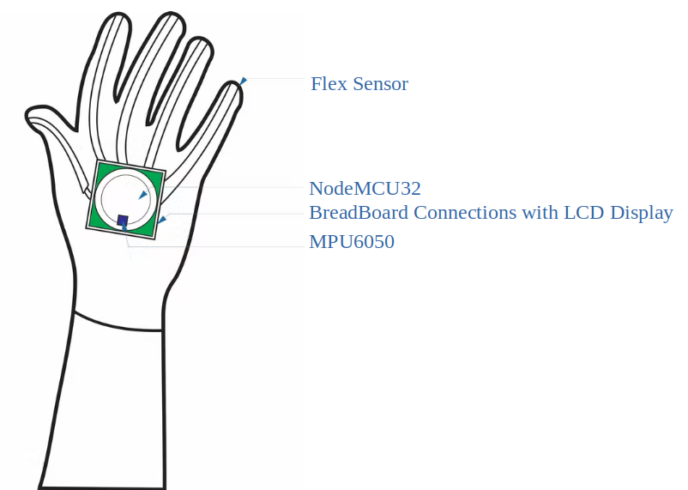
OBJECTIVES
From a viewpoint of specially-abled people who can move their fingers or toes, we have designed a glove that will assist.
Glove will not just help the specially-abled community but also the common people in controlling their appliances.
Developing a glove with gesture and sign language voice assistant which outputs data as per the input received.
Figure 1: Flex Sensor with Accelerator on Gloves
20/05/2022
20/05/2022
<number>

Slide 5
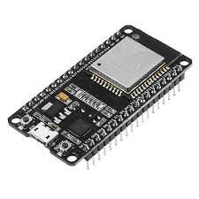
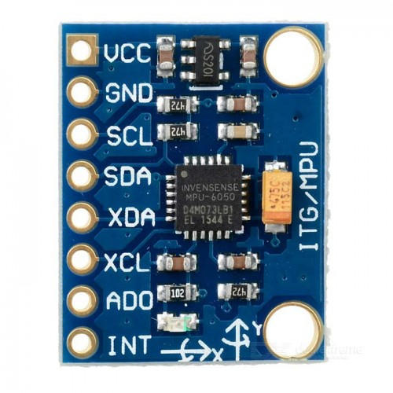
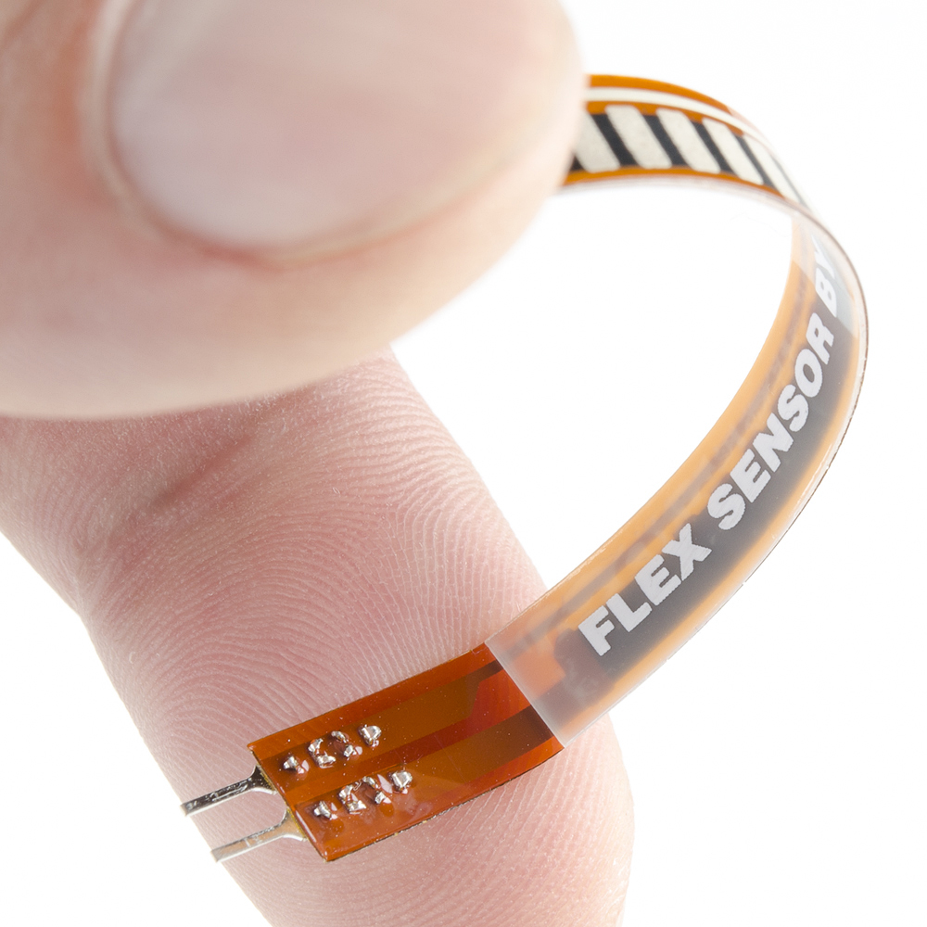
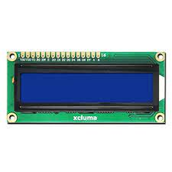
PROPOSED METHODOLOGY
COMPONENTS USED
Flex Sensor (Conductive Ink)
Accelerometer (MPU 6050)
Node MCU-32 (ESP32)
LCD Display
Wires
Breadboard
Resistances
SOFTWARE USED
Arduino IDE
20/05/2022
Figure 2: Components to be used in the project
20/05/2022
<number>

Slide 6
PROPOSED METHODOLOGY
BLOCK DIAGRAM
Flex Sensor
LCD Panel 16 X 2
Flex Sensor
Flex Sensor
ESP 32
Development
Kit
Flex Sensor
Flex Sensor
MPU 6050 Module
Figure 3: Block Diagram of Gesture & Sign Language
20/05/2022
<number>

Slide 7
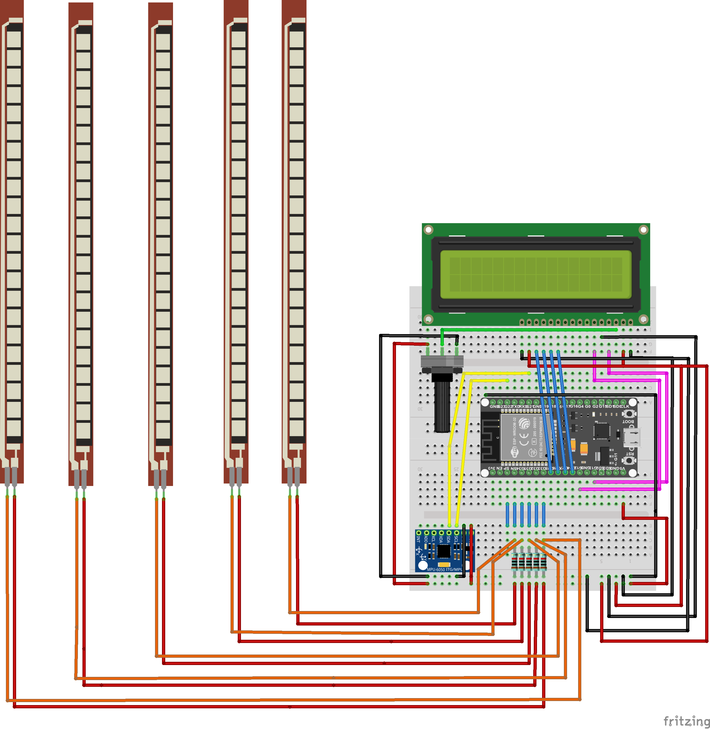
PROPOSED METHODOLOGY
IMPLEMENTING CIRCUIT
START
Readings from Flex Sensor and MPU 6050
If Values of Flex Sensor OR MPU 6050 changes
NO
YES
20/05/2022
Printing Gestures
END
Figure 4:Circuit Implementation of Gesture & Sign Language
Flow Chart
20/05/2022
<number>

Slide 8
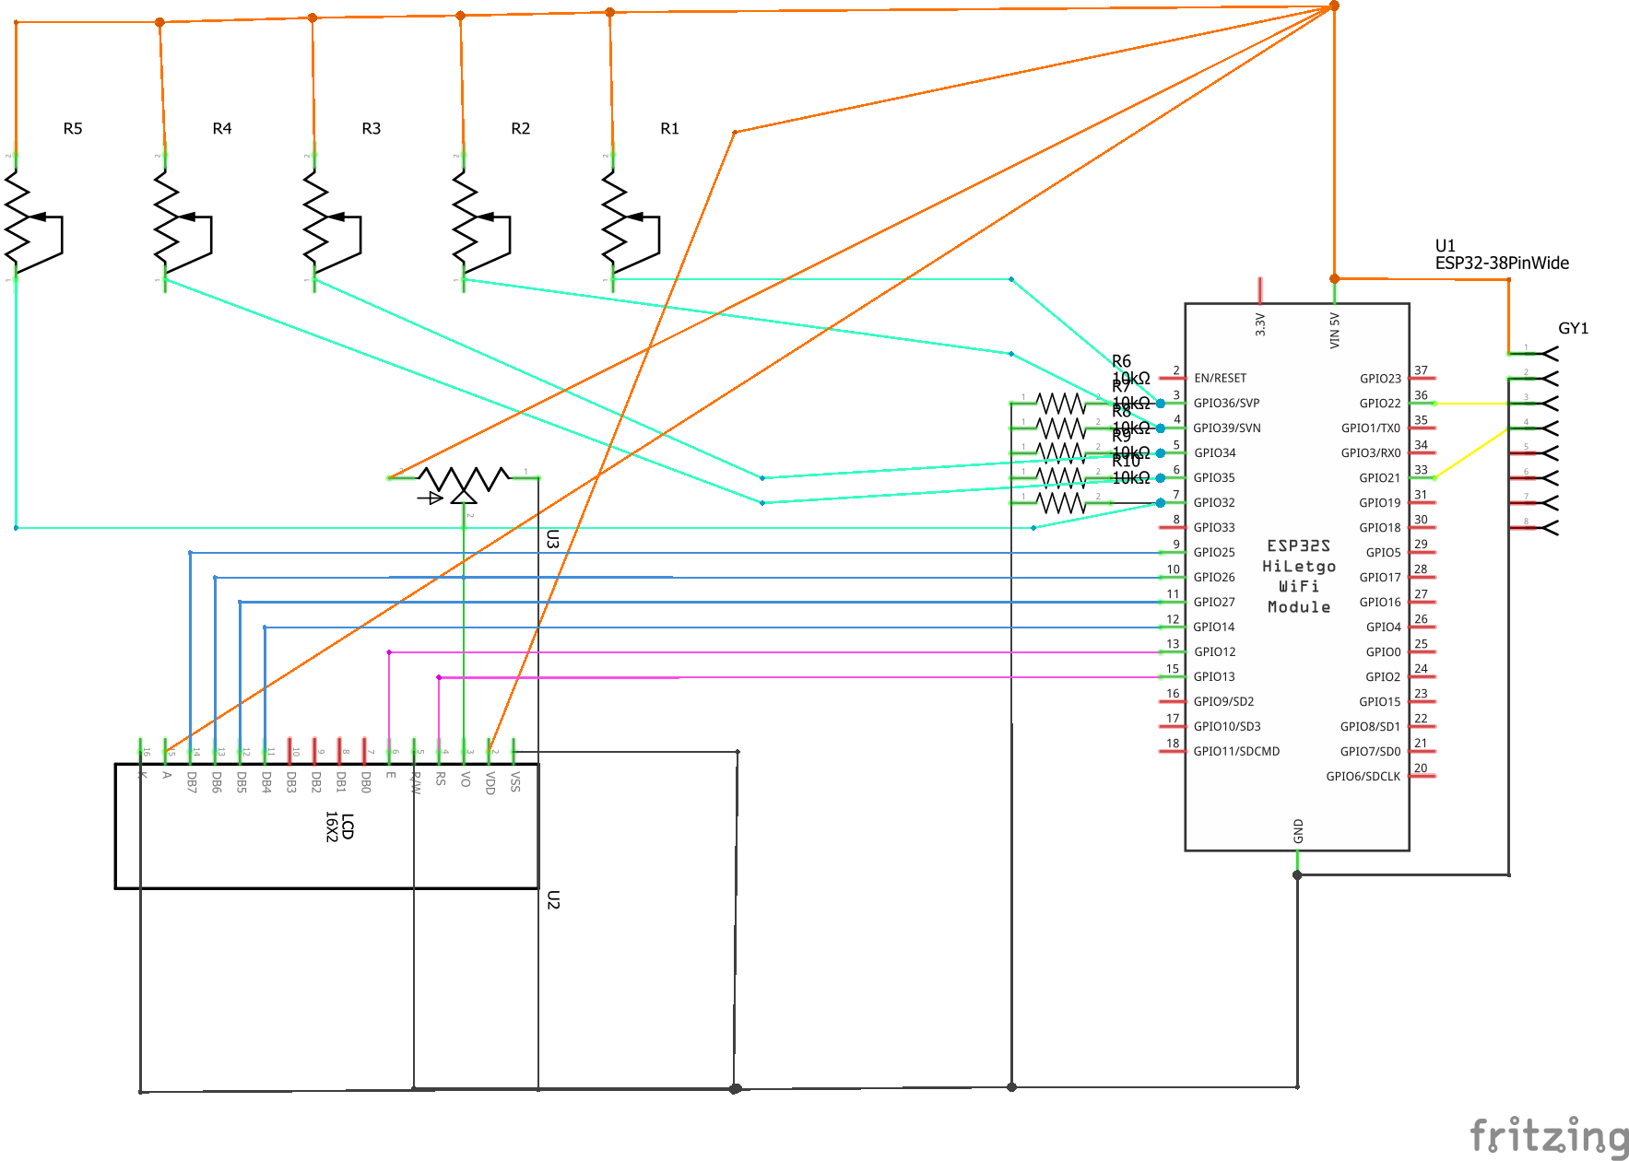
PROPOSED METHODOLOGY
SCHEMATIC
20/05/2022
Figure 5: Schematic of Gesture & Sign Language
20/05/2022
<number>

Slide 9
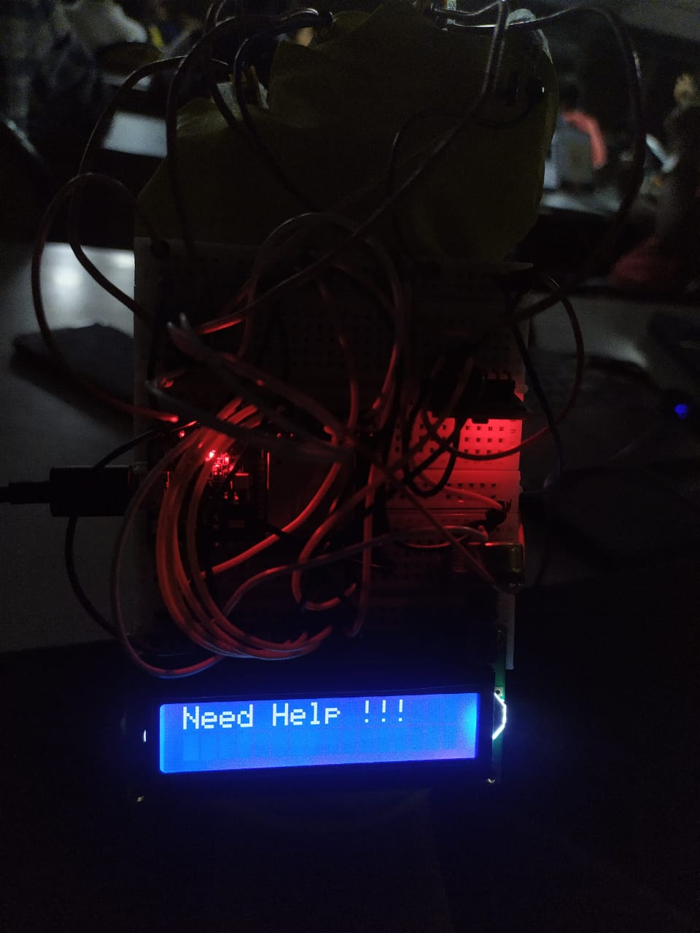
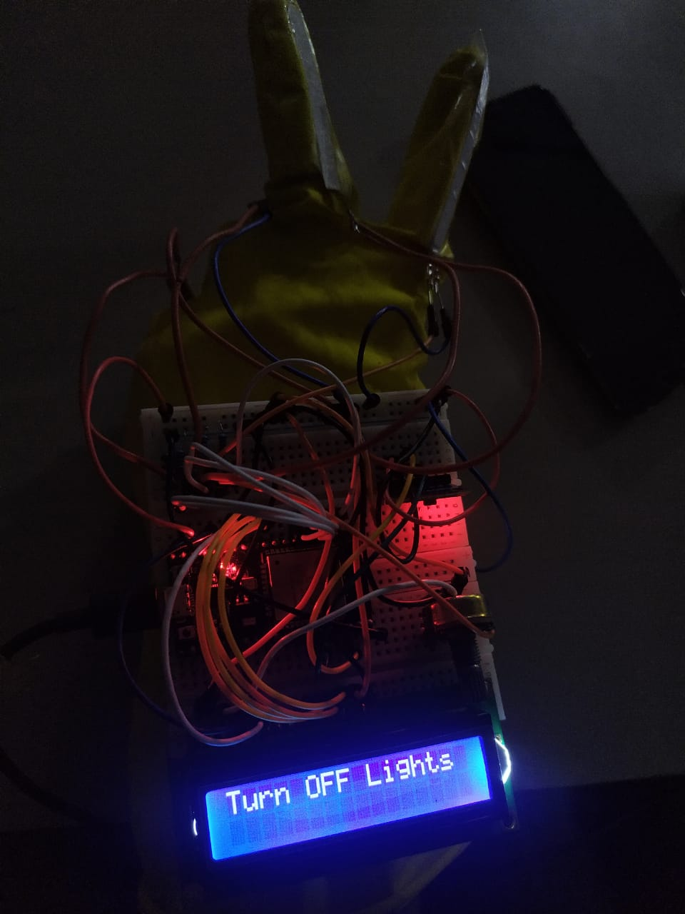
IMPLEMENTATION
Taking Readings from Flex Sensor and MPU6050
20/05/2022
20/05/2022
Figure 6: Circuit Diagram and Output
20/05/2022
9

Slide 10
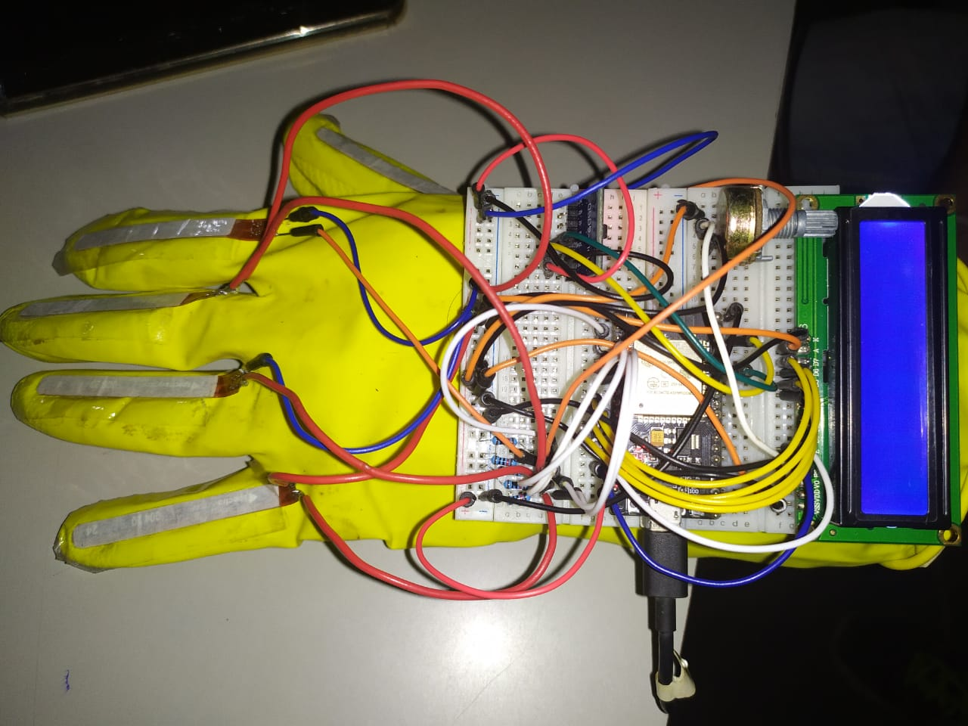
IMPLEMENTATION
Printing Gesture on LCD Panel
20/05/2022
20/05/2022
Figure 7: Circuit Diagram and Output
20/05/2022
10

Slide 11
RESULT & FUTURE WORK
Integrating Sign Language.
Integrating the entire system with mobile application like Messenger App
Adding IoT and Bluetooth to this project for voice assistance.
20/05/2022
20/05/2022
12

Slide 12
REFERENCES
[1] Solanki Krunal M.” Indian Sign Languages using Flex Sensor Glove” International Journal of Engineering Trends and Technology (IJETT) - Volume4 Issue6- June 2013.
[2]Aarthi M et.al. ”Sign Language to Speech Conversion” Fifth International Conference on Recent Trends in Information Technology, 978-1-4673-9802-2/16/$31.00© 2016 IEEE
[3] Anagha J. et.al. "AVR based embedded system for speech impaired people" 2016 International Conference on Automatic Control and Dynamic Optimization Techniques (ICACDOT) International Institute of Information Technology (I²IT), Pune 978-1-5090-2080-5/16/$31.00 ©2016 IEEE
[4] Singh Chouhan A. "Indian Sing Language Translator Using Flex Sensor Gloves" IOSR Journal of Electronics and Communication Engineering (IOSR-JECE) e-ISSN: 2278-2834,p- ISSN: 2278-8735.Volume 11, Issue 6, Ver. III (Nov.-Dec .2016), PP 12-14 10.9790/2834-1106031214
20/05/2022
20/05/2022
13

Slide 13
REFERENCES
[5]Alex Rupom H. et.al.” Deaf-Vibe: A Vibrotactile Communication Device Based on Morse Code for Deaf-Mute Individuals” 9th IEEE Control and System Graduate Research Colloquium (ICSGRC 2018), 3 - 4 August 2018, 978-1-5386-6321-9/18/$31.00 ©2018 IEEE
[6]Yudhana A et.al. “ Flex sensors and MPU6050 sensors responses on the smart glove for sign language translation” 1st International Conference on Engineering and Applied Technology (ICEAT), Materials Science and Engineering 403 (2018) 012032 10.1088/1757-899X/403/1/012032
[7] Kollu Jaya L. et.al. “Patient Assistance using Flex Sensor” International Conference on Communication and Signal Processing, July 28 - 30, 2020, 978-1-7281-4988-2/20/$31.00 ©2020 IEEE
[8]Ail S. et.al. “ Hand Gesture-Based Vocalizer for the Speech Impaired” Springer Nature Singapore Pte Ltd. 2020, 10.1007 /978-981-15-1002-1_59
20/05/2022
MINI PROJECT 2021
20/05/2022
<number>

Slide 14
THANK YOU !
20/05/2022
MINI PROJECT 2021
20/05/2022
MINI PROJECT REVIEW
15

